Slide 1
Website Tips & Tricks
Training 1
Routes & Places
Scheduling an Activity

Slide 2
Overview
Routes & Places: utilized by CMC volunteers to discover places to host activities, not typically viewed by participants
Start by going to Find Routes & Places under the Education & Adventure tab of the new website
Explore the database of existing R&P
Utilize the search box, filter by category, or display the map view
If you do not see the R&P for the area you’d like to visit, click the blue button to add a new Route & Place (option to select the R&P TBD and follow next steps under Schedule an Activity)
Enter information in a guidebook format that is general enough for any CMC volunteer to use
Important for tracking, managing conflicts, and following public land guidelines
Click Save and Submit for Publication
You will be notified when your R&P is published
Scheduling an Activity: process of posting trips/field days so members can sign up
Start by going to Find Routes & Places under the Education & Adventure tab of the new website
Explore the database of existing R&P
Utilize the search box, filter by category, or display the map view
Once you’ve decided on a R&P you’d like to visit, you’re ready to schedule an activity
Decide whether you want to lead a trip, course lecture/field day, or seminar/clinic as well as the date then click Book
Enter your specific trip information into the boxes
Click Save, and your trip is published

Slide 3
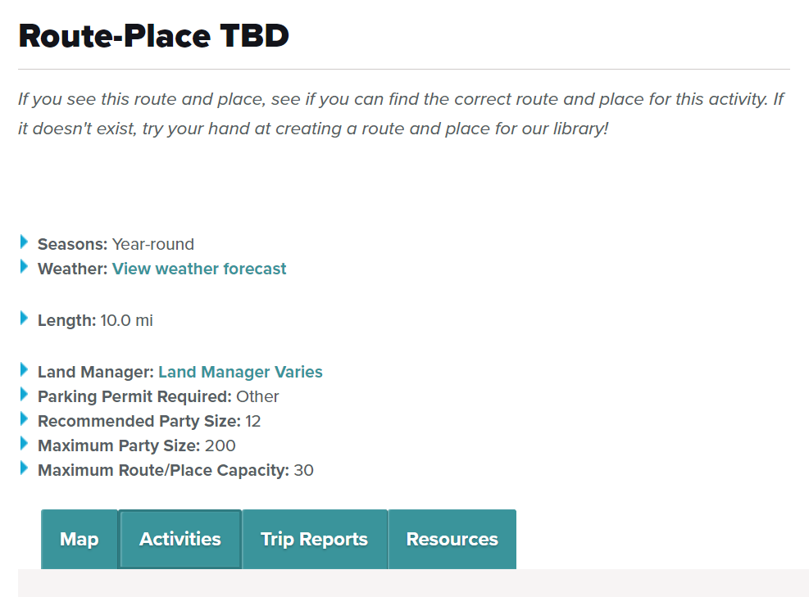
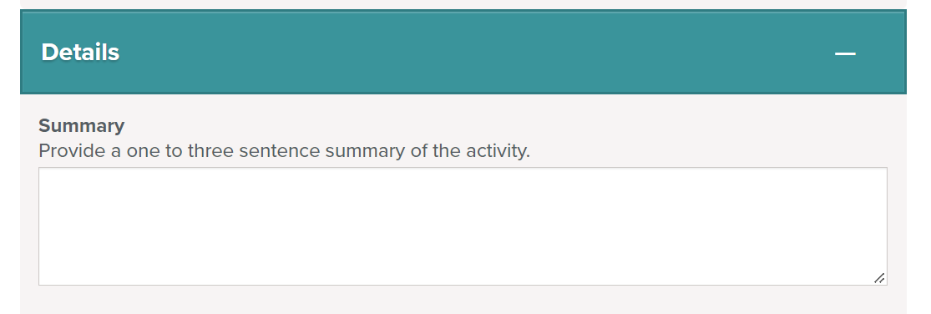
Route-Place TBD
Alternative
On the Find Routes & Places page, search TBD in the search box on the left hand side
This is a placeholder for a Route & Place that has yet to be created
This allows you to schedule an activity in one step, but it is encouraged to also create a new Route & Place for your location
The TBD does not provide useful data in reports, does not check for conflicts, nor does it provide public land guidance on group size limits, parking passes, or permits
The summary field turns into the title, which leads to unstructured formatting

Slide 4
Routes & Places
Why is it important to create Routes & Places?
To build a CMC database of trails and locations where our members like to recreate
To provide guidance to volunteers planning activities
To follow regulations set by land managers
To minimize our impact on the land by reducing scheduling conflicts
When are they reviewed?
Routes & Places are reviewed twice weekly
Roberta reviews on Monday
Alissa reviews on Thursday
The creator of the R&P is notified by email when it has been published or if changes are needed
How can I make an edit once a R&P has been published?
Visit the page for the R&P you wish to edit
Click on the link on the right hand side that says, “Send us updates, images, and resources”
Fill in any of the fields for which you would like a change
An email will be sent to Roberta who will apply the changes

Slide 5
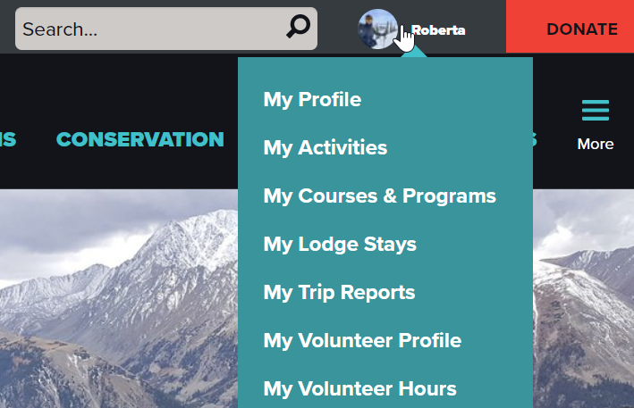
Activities
To find the activity you just created, hover over your name in the upper right hand side of the webpage
Click My Activities for trips, field days, or events
Click My Courses for courses
Select an activity or course to view the information and roster
From this page you can make edits that will appear live for others to see
Bonus tip: You can input your volunteer hours under My Volunteer Hours. Track and report the amount of time you contribute to creating Routes & Places, Scheduling Activities, and more.

Slide 6
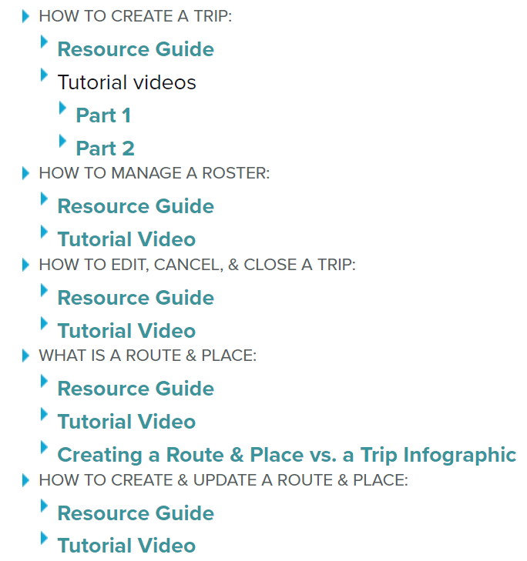
Additional Resources
Badge Request Form
https://docs.google.com/forms/d/e/1FAIpQLSdIIzru9pc6Wr3GwjHRS0Q1olnJbwgkXHyyaRMwlGWhcxTW0w/viewform
Website questions or concerns for the Education Team
https://docs.google.com/forms/d/e/1FAIpQLScMAfOM4tg_7PhhBqhKggY8q8-dls9w2jfmQUOtx8SATNK-bQ/viewform?usp=sf_link
Leader Resources

