Slide 1
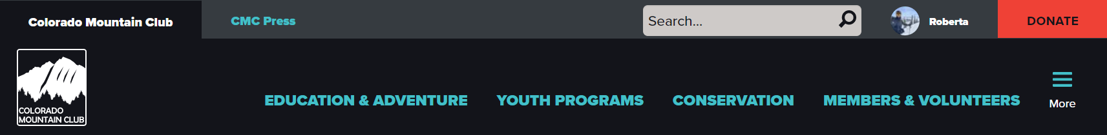
Website Tips & Tricks
Training 5
How to utilize filters
on “Find Routes & Places” and “Find Trips”

Slide 2
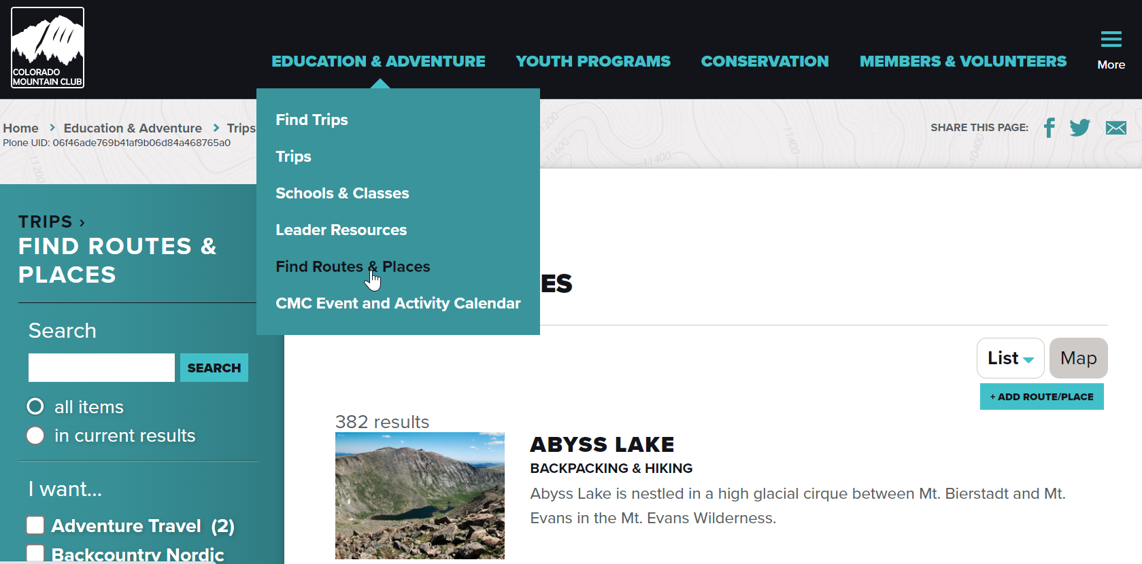

Slide 3
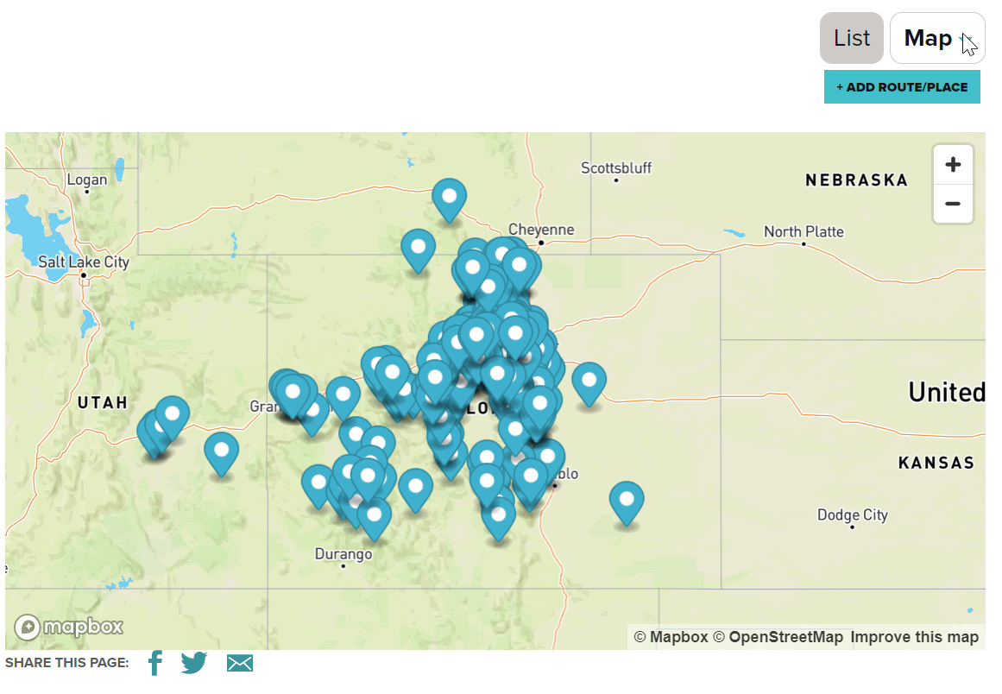

Slide 4
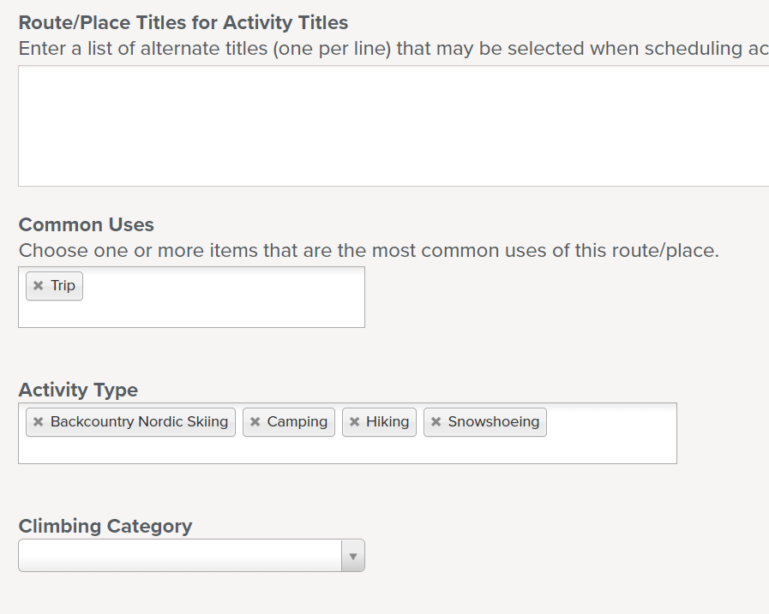
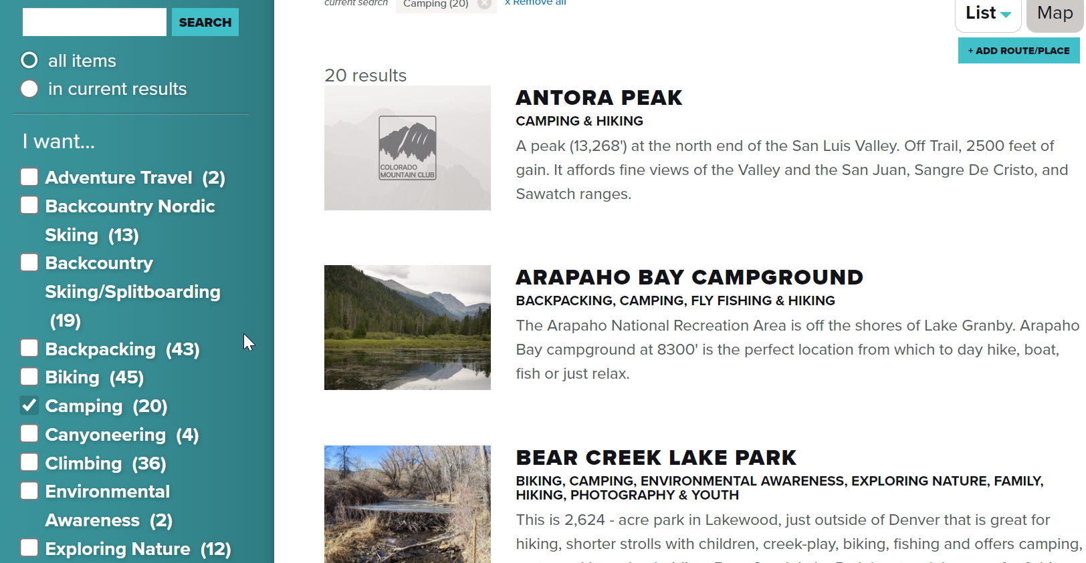
Filter by Activity Type
The activity type is noted in bold under the title
Activity types are entered by the creator of a R&P

Slide 5
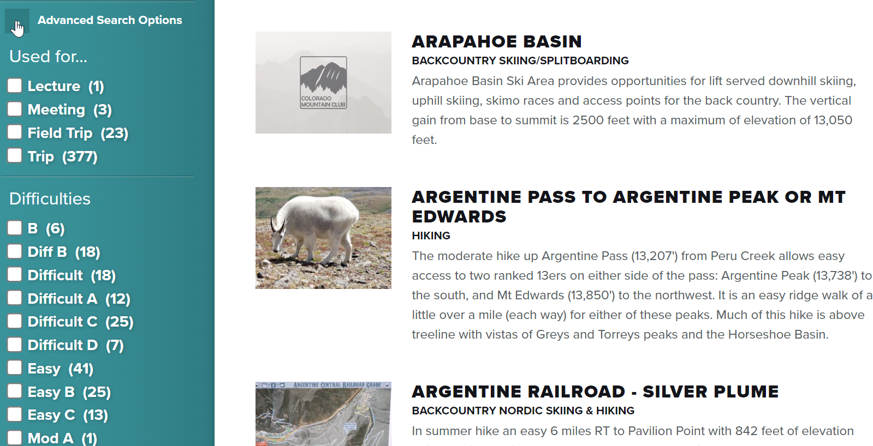
Advanced Search Options
Refer to the new Difficulty Rating system to classify the R&P as Easy, Moderate, Challenging, or Difficult
This will become a drop-down list in R&P and all current R&P will be reviewed and edited to follow this system

Slide 6
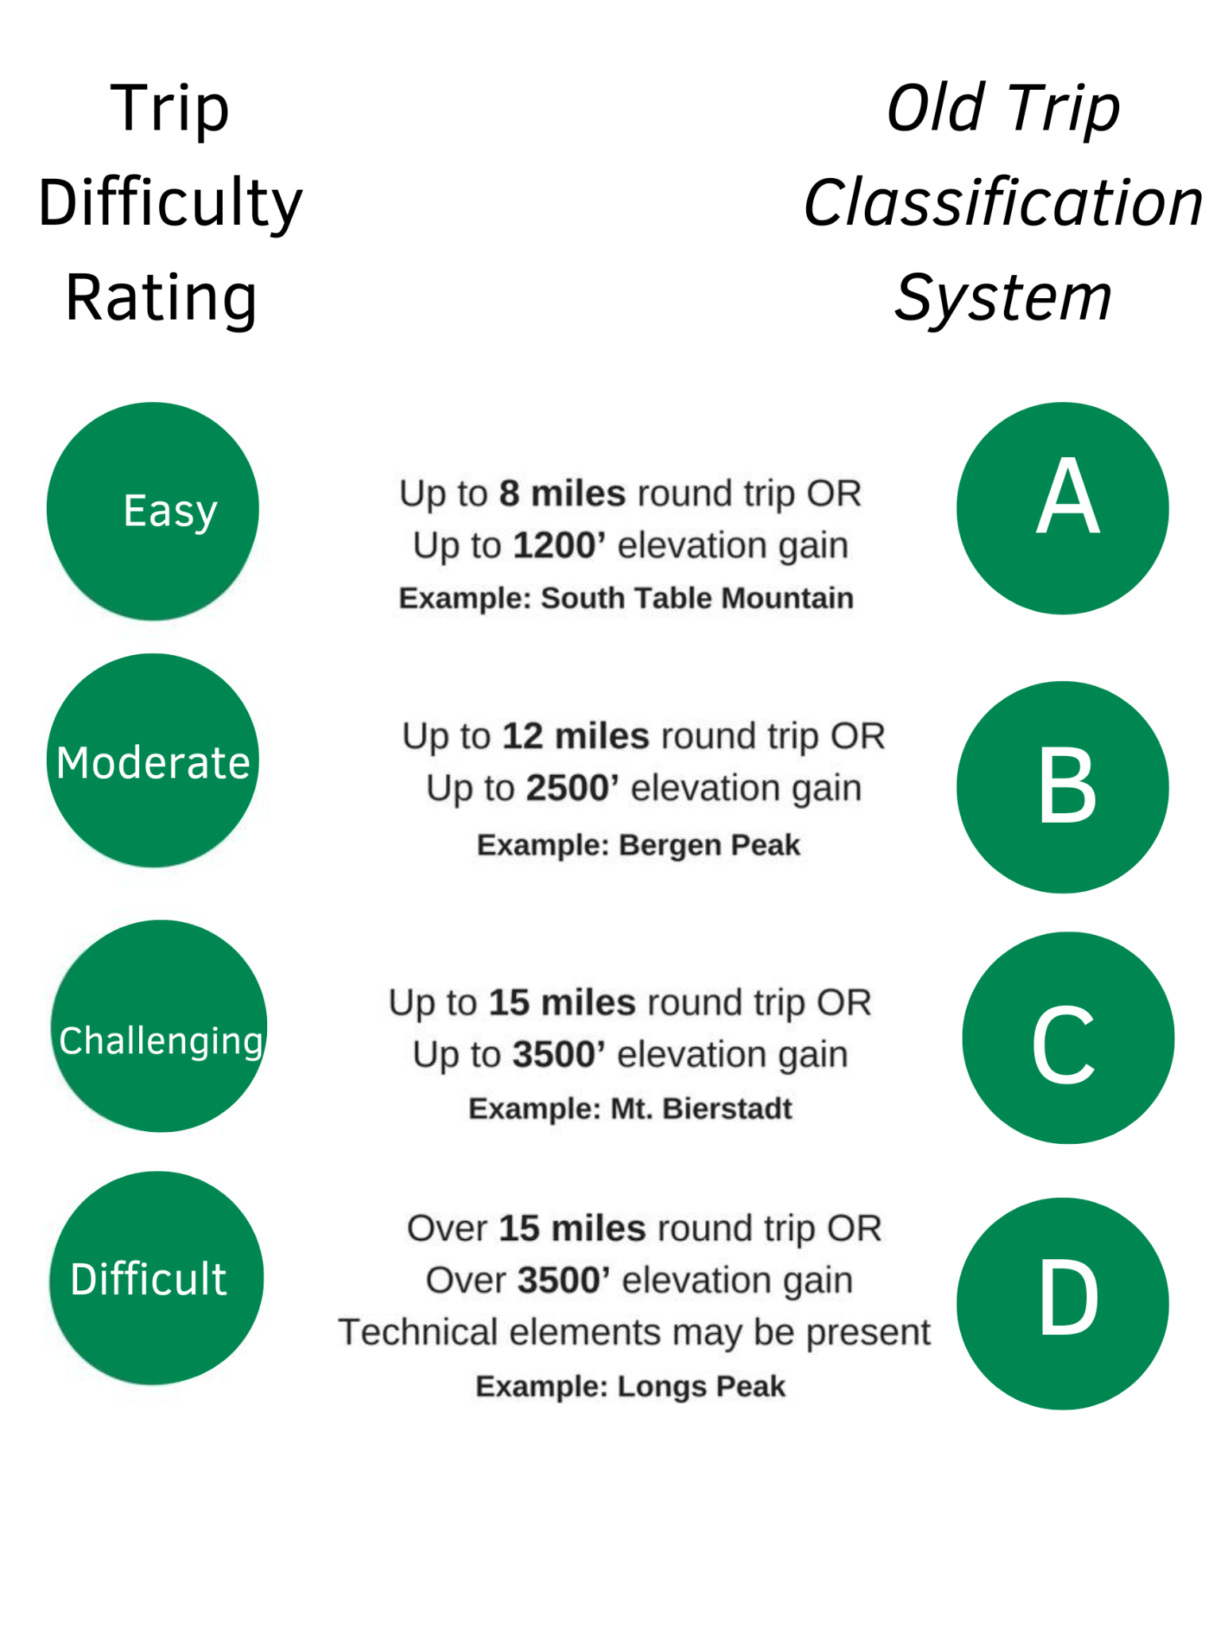

Slide 7
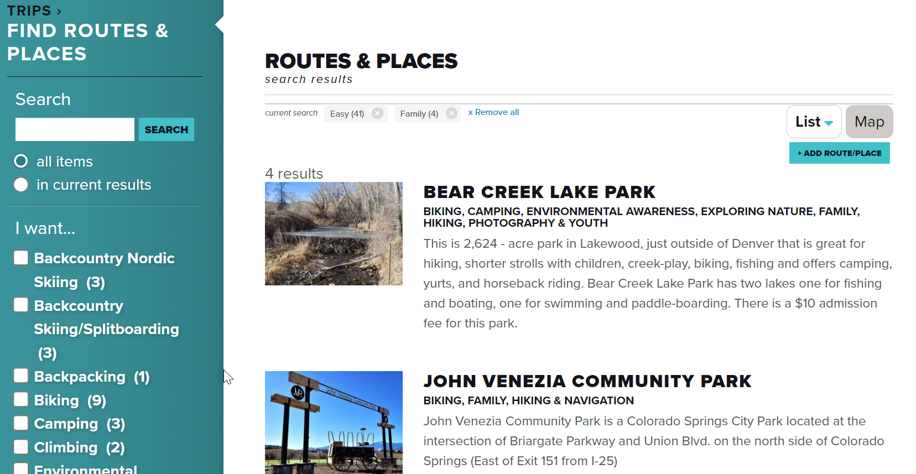
Filtering Routes & Places helps leaders/instructors choose where to lead their activity.

Slide 8
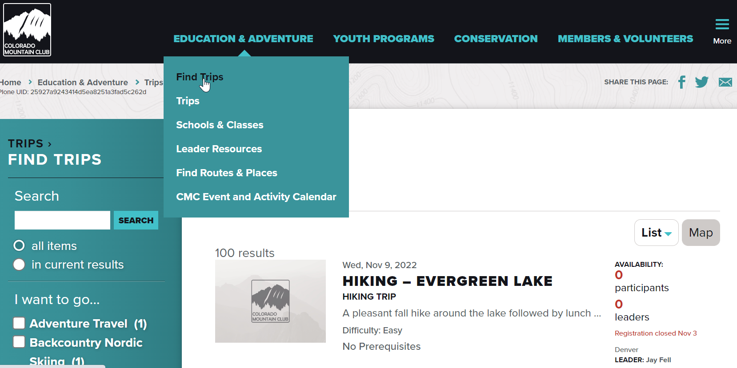

Slide 9
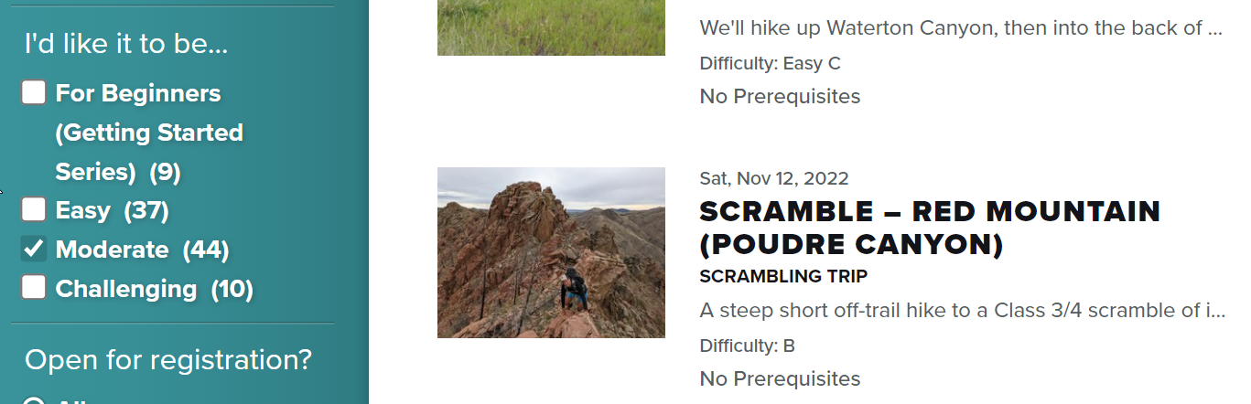
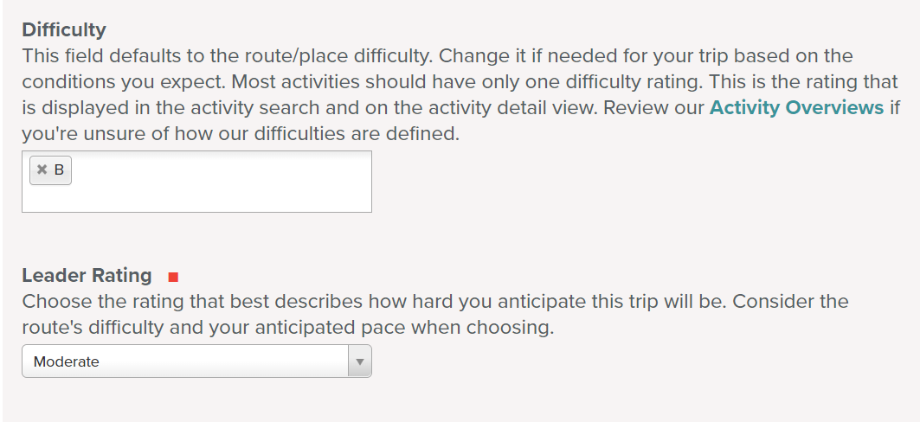
I’d like it to be…describes the trip
Difficulty: describes the route (from R&P)
Leader Rating: describes your trip
This is confusing…
eliminate Leader Rating
standardize Difficulty rating
keep filter

Slide 10
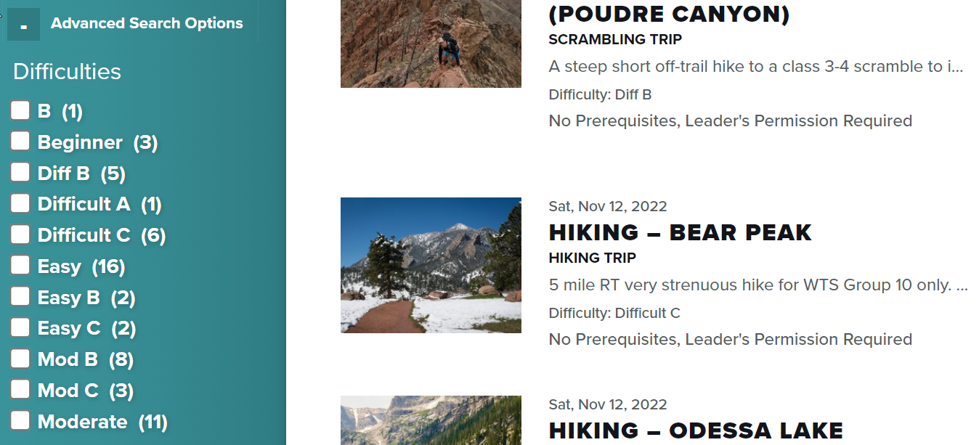
Advanced Search Options
Difficulties under Advanced Search Options is describing the difficulty of the route
This filter will be removed

Slide 12
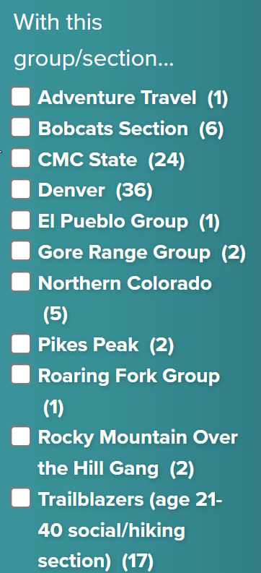
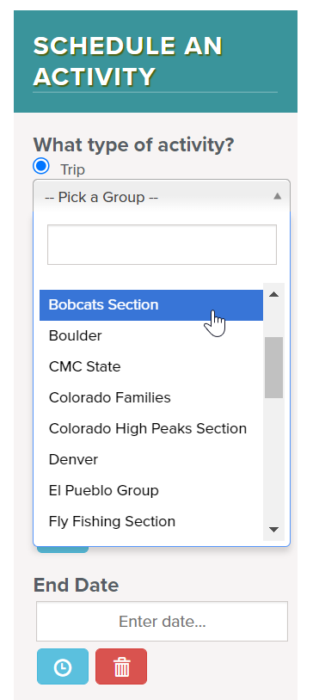
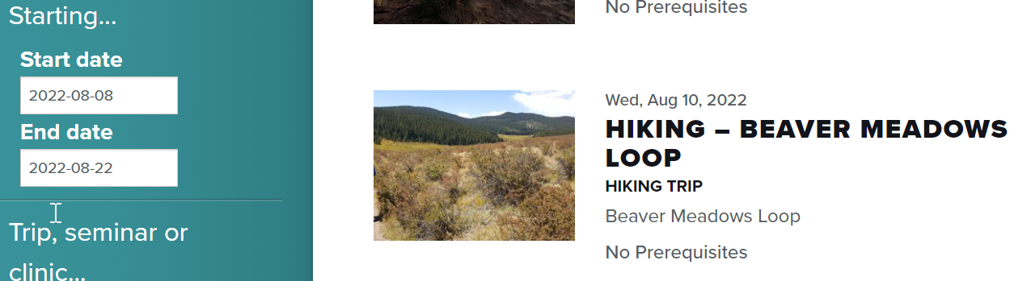
More fun filters
Did you know you can search for past trips?
You can filter by the sponsoring Group/Section
This is determined when a leader schedules an activity.

Slide 13
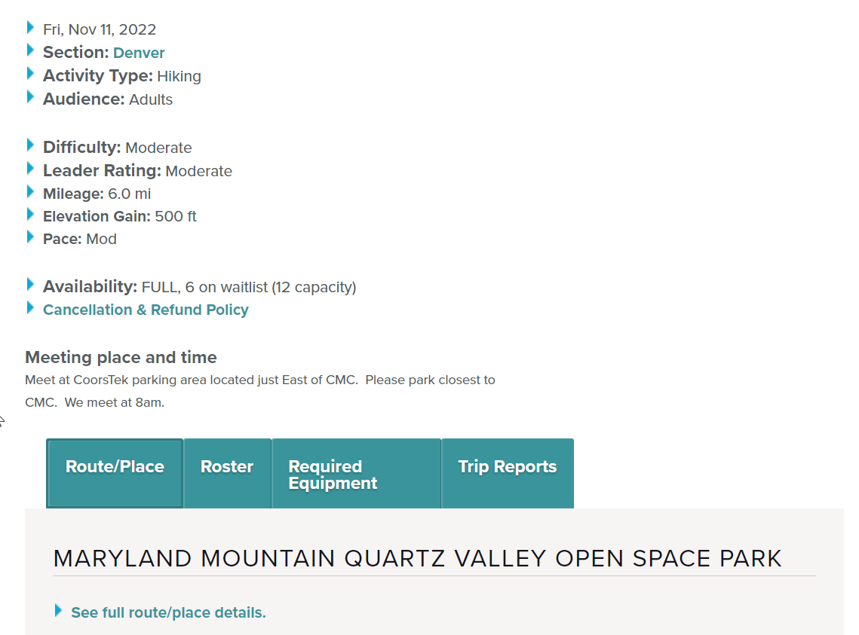
This information is also available within the scheduled activity. You can also click on the Route & Place to see more details there.

Slide 14
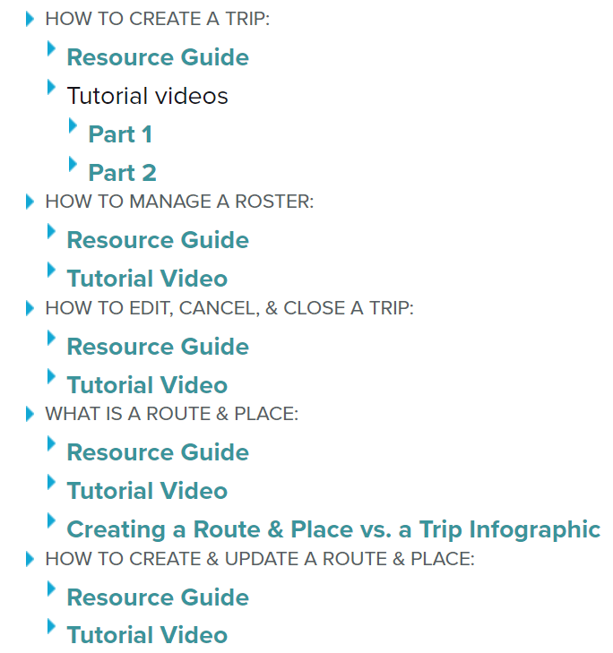
Additional Resources
Badge Request Form
  https://docs.google.com/forms/d/e/1FAIpQLSdIIzru9pc6Wr3GwjHRS0Q1olnJbwgkXHyyaRMwlGWhcxTW0w/viewform
Website questions or concerns for the Education Team
  https://docs.google.com/forms/d/e/1FAIpQLScMAfOM4tg_7PhhBqhKggY8q8-dls9w2jfmQUOtx8SATNK-bQ/viewform?usp=sf_link
Leader Resources

