Slide 1
Website Tips & Tricks
Training 6
Admin Panel demystified on CMC.org

Slide 2
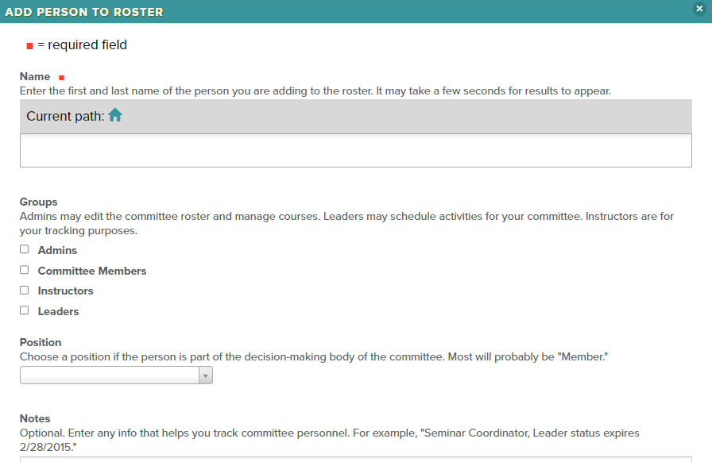
User permissions and designations

Slide 3
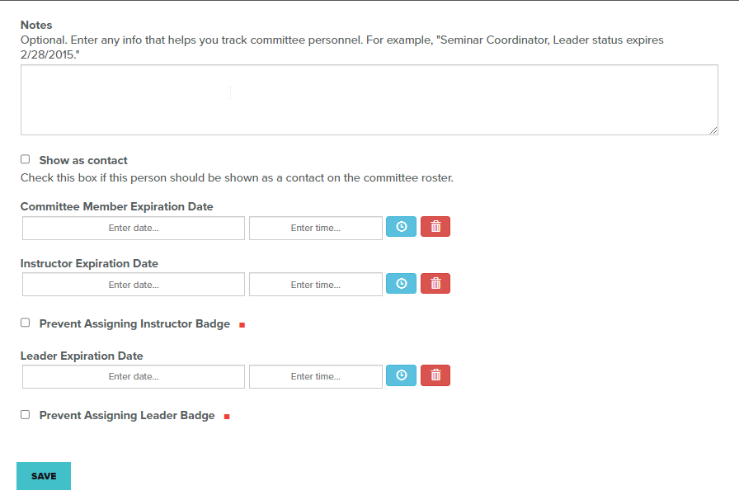
Additional Information that can be applied.

Slide 4
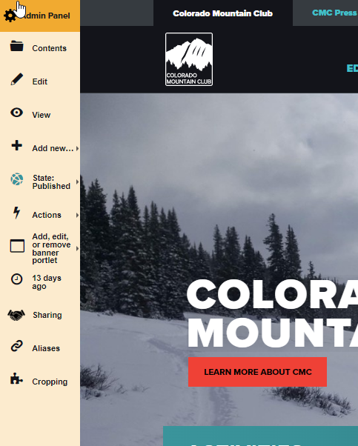
Contents: A list View of all of the contents on this page.

Slide 5
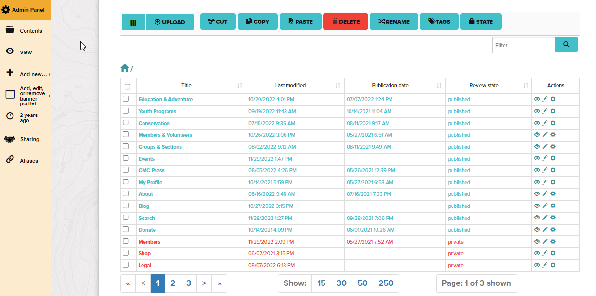
Contents: A list View of all of the contents on this page.

Slide 6
Title = Name of file / Last Modified / Publication Date /
Review State/ Actions

Slide 7
Button Options: Grid / Upload / Cut / Copy / Paste / Delete /
Rename Tags / State

Slide 8
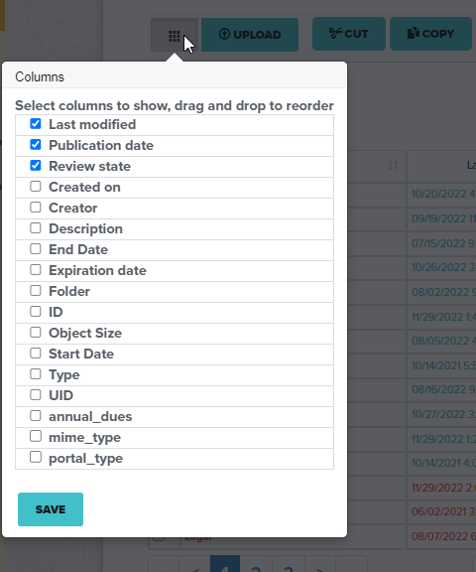
Grid: Additional Options that can be added to display columns.

Slide 9
Copy & Paste: Duplicating a file. Warning!
This can duplicate the URL.

Slide 10
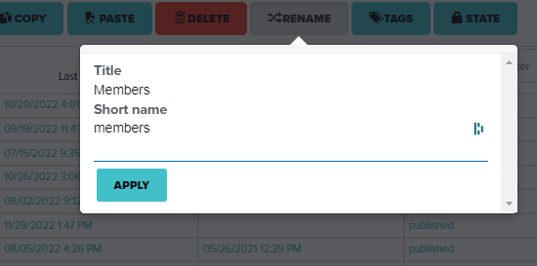
Rename: Changing the URL

Slide 11
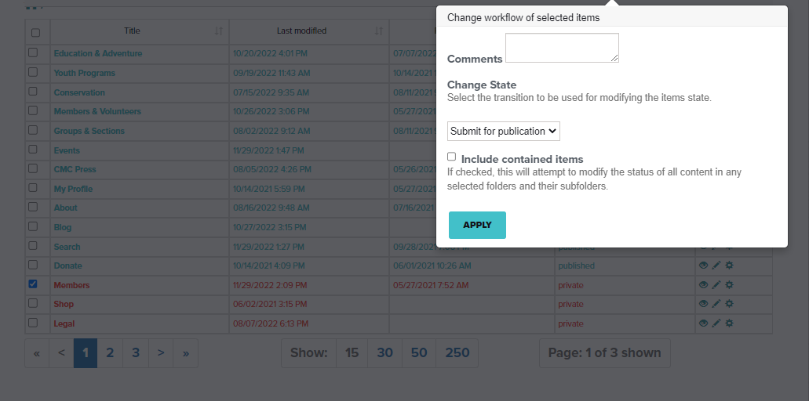
State: Different options for publishing.

Slide 12
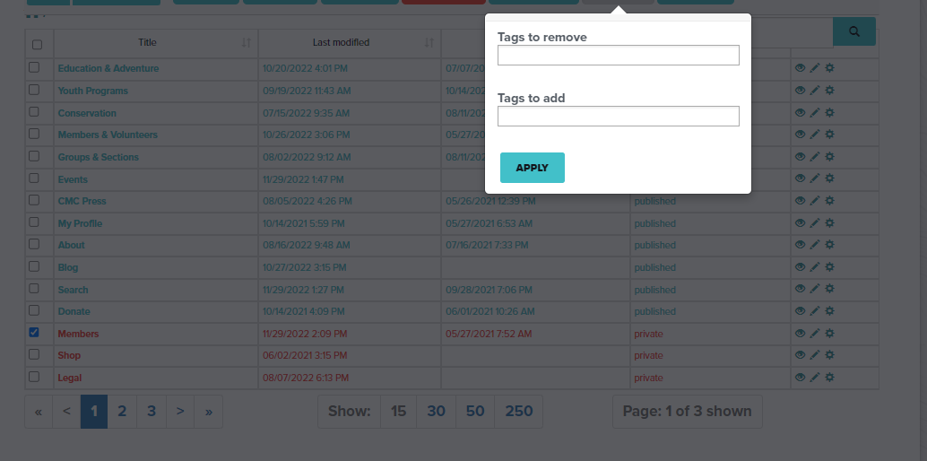
Tags: Important for adding visibility in search function.

Slide 13
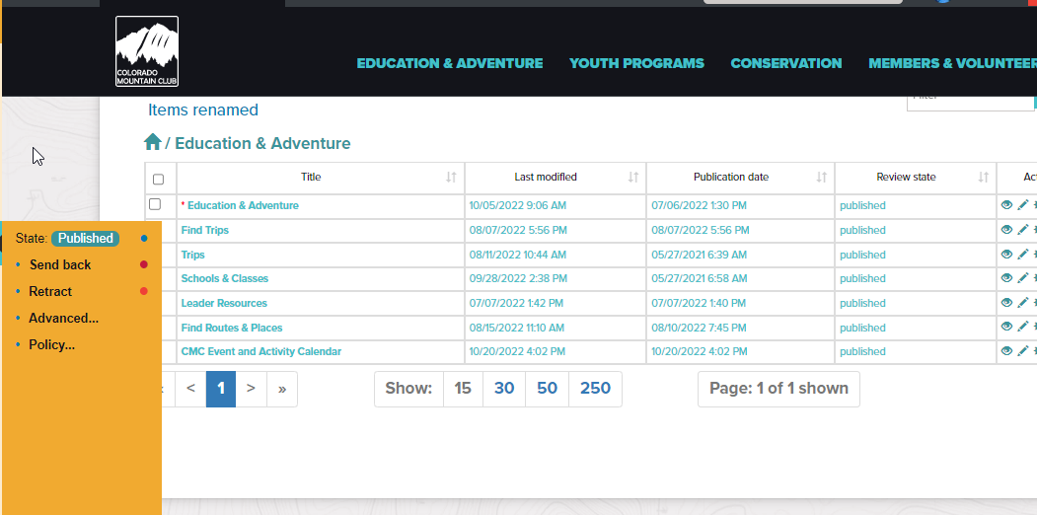
State: Published / Send back / Retract / Advanced… / Policy…

Slide 14
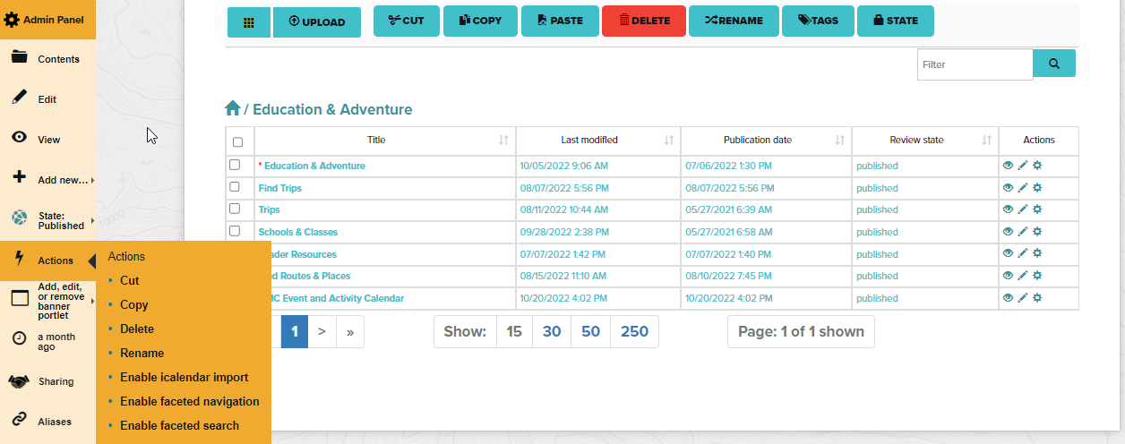
Actions: do not use : /

Slide 15
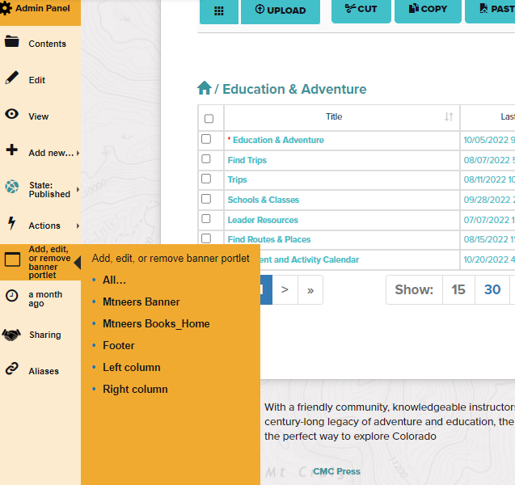
Add, edit, or remove banner portlet: do not use : /

Slide 16
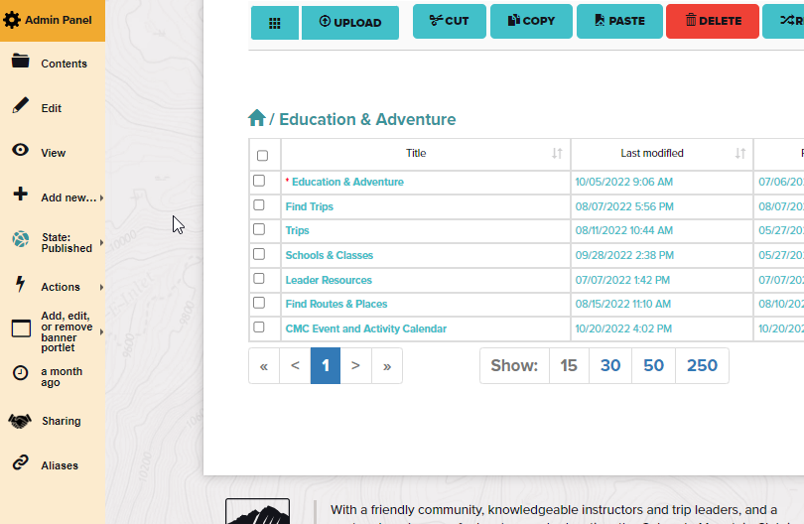
Last Edit: Timestamp

Slide 17
Sharing: Multiple pages that share the same information.

Slide 18
Aliases: Multiple pages that share the same information.

