Slide 1
Website Tips & Tricks
Training 7
How to lead an activity again, clone, copy & paste

Slide 2
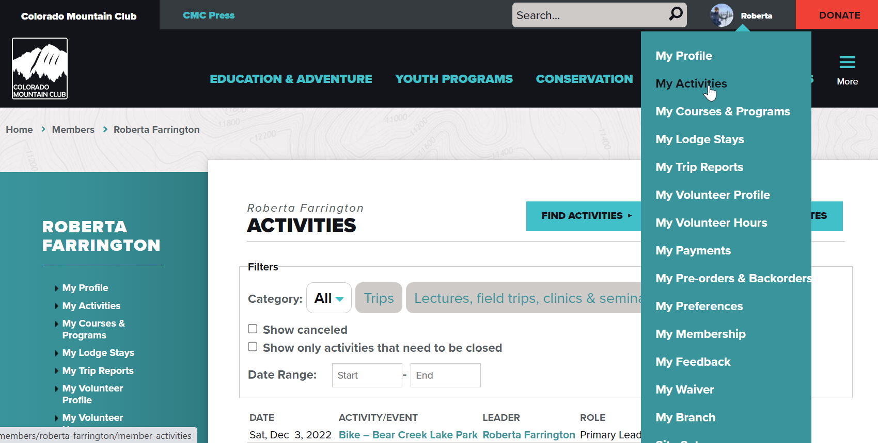
Lead Activity Again

Slide 3
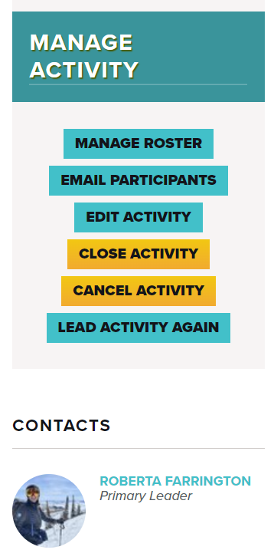
You only have this capability for your own activities.
You cannot view someone else’s trip and try to lead it again.

Slide 4
Takes you back to the Route & Place
Go to My Activities under your profile
Select the Trip you want to repeat
Click Lead Activity Again on the right-hand side
It takes you back to the Route & Place where you have to schedule the activity again
Information from your past trip is NOT copied over

Slide 5
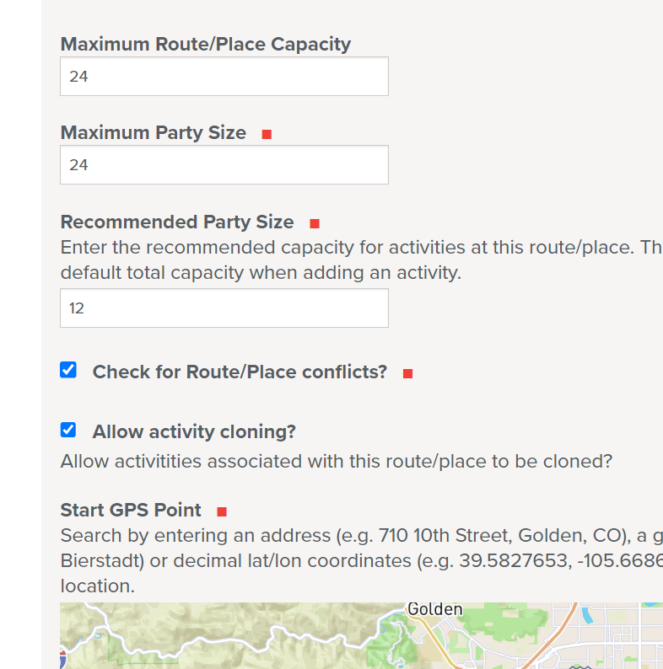
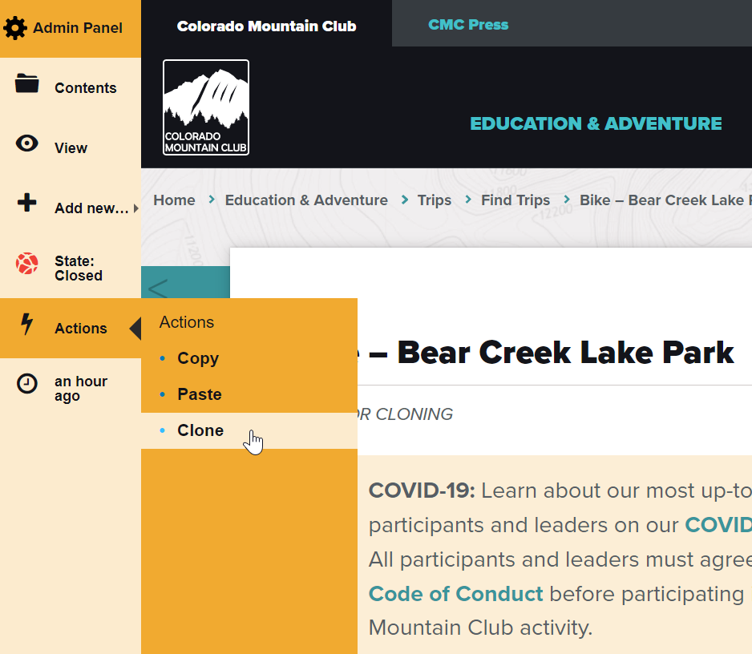
Cloning Activities
Route & Place has to be checked to allow activity cloning
Access on Admin Panel to Clone under “Actions”

Slide 6
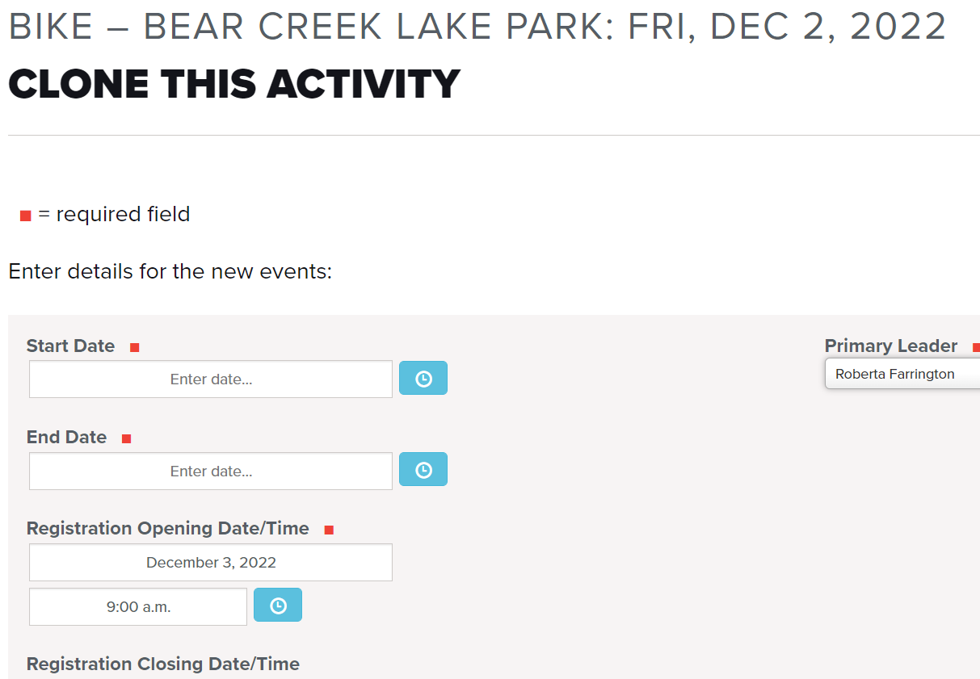
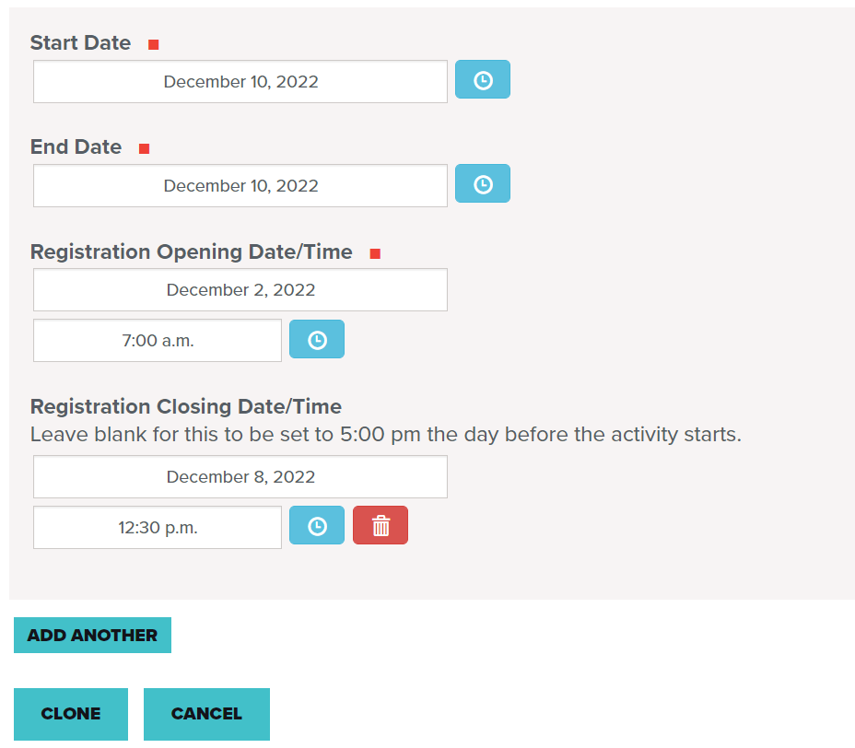
Note on Cloning from the Mountaineers:
Cloning does not check for conflicts. It will not check if someone is registered for another trip on the same day as your trip.
Cloning copies all of the information from the previous activity
You can clone other people’s activities
You can clone the same activity for multiple future dates by selecting “Add Another”
Ex. New Member Hikes every month @ Apex

Slide 7
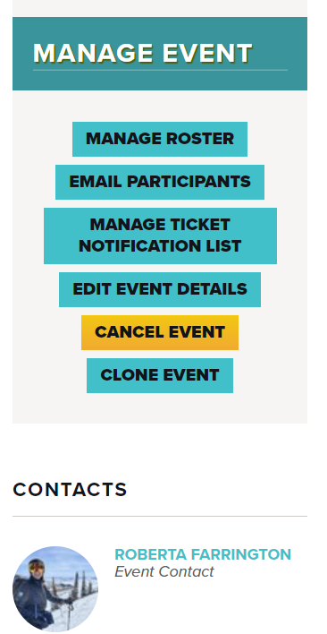
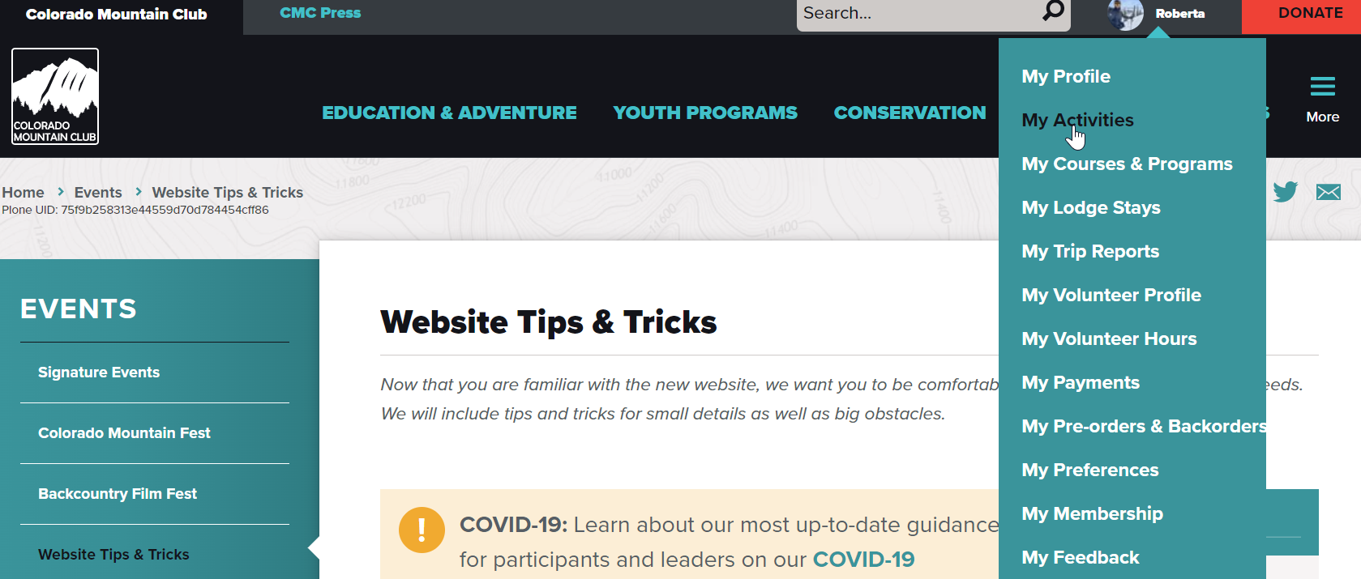
Cloning Events
You can only clone your own events. You cannot clone someone else’s event.

Slide 8
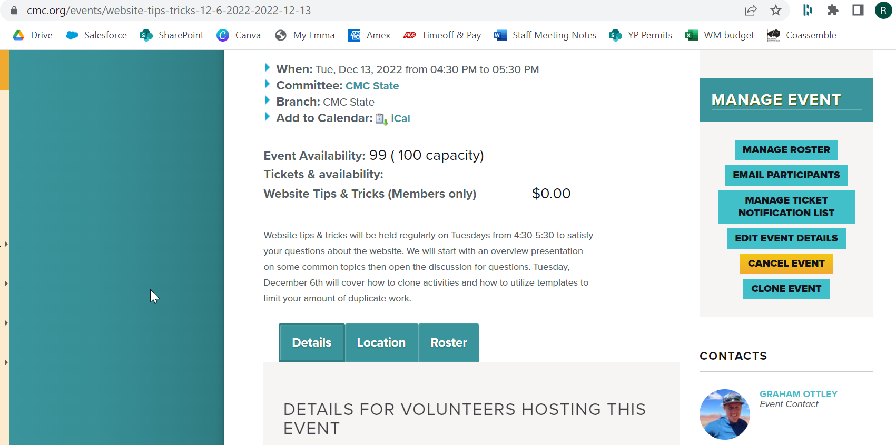
Rename URL

Slide 9
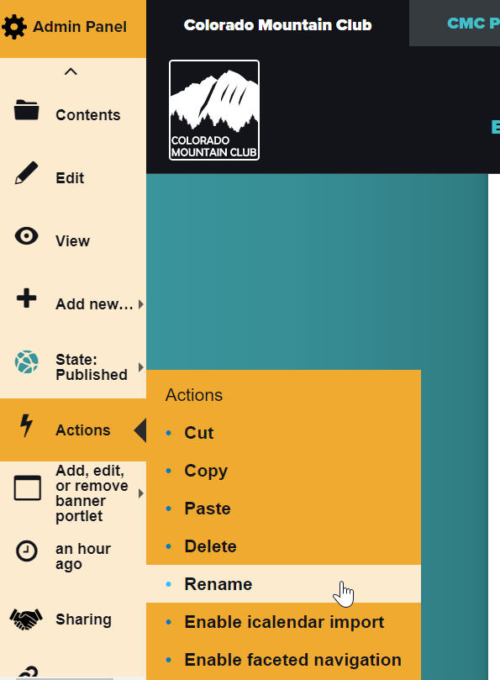
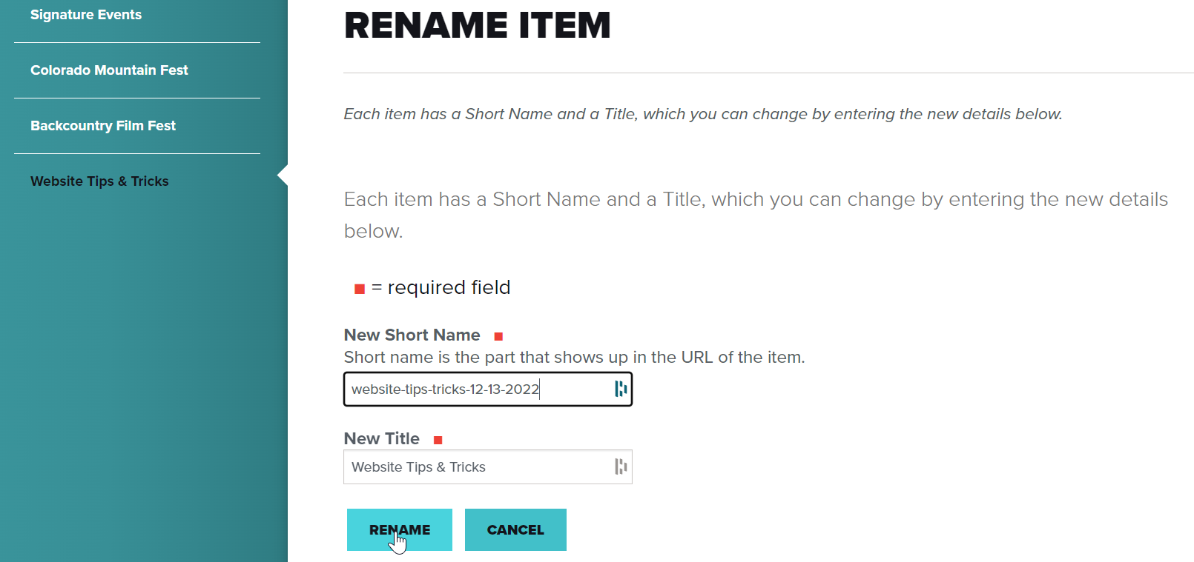

Slide 10
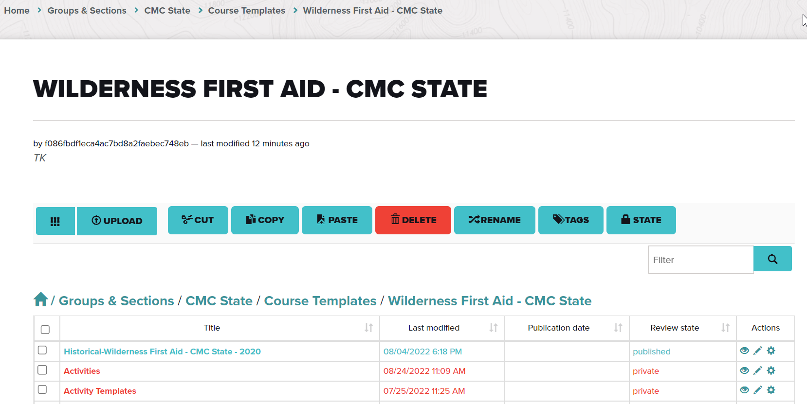
Copy & Paste
Useful for School Directors who are scheduling the same course multiple times

Slide 11
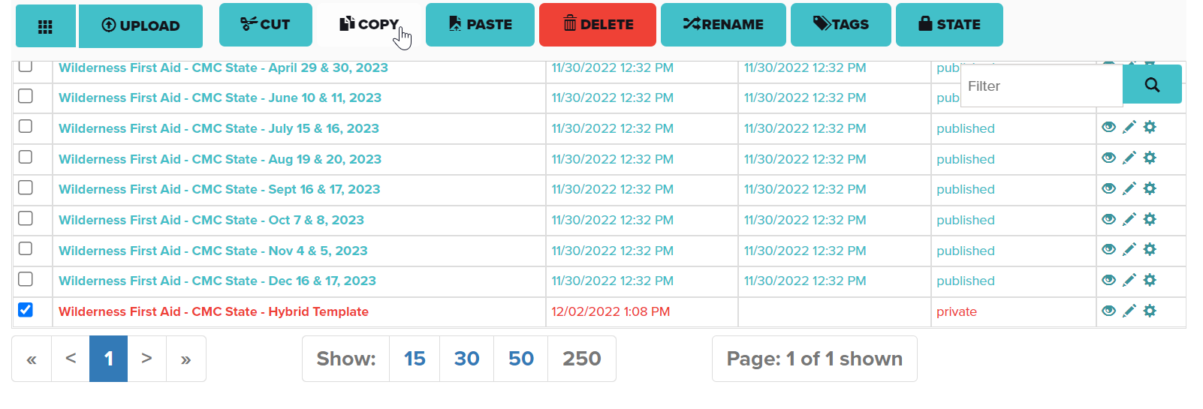
Start by creating a course in your course template folder
Do not publish it
Title it “template” so you know which to copy in the future
In the contents view, select the course, then choose copy from the top menu bar
All information stays the same
Change title
Publish your new course
You will be able to keep your template to repeat this process in the future
Don’t try this with a published course because it will copy the roster

Slide 12
Scenario
Wants to lead a snowshoe trip to IPW which has a group size limit of 12
Knows the trip will be popular, wants to have a co-leader and split the group
What is the best way to do this on the website?
Increase group size capacity on the Route & Place so you can increase your group capacity on the schedule activity page
Once your trip is created, go to the roster, enter the name of your co-leader and give them the “co-leader” designation under participant role
It will be your responsibility to split the group into two smaller sizes to follow the land manager regulations once at the trailhead

Slide 13
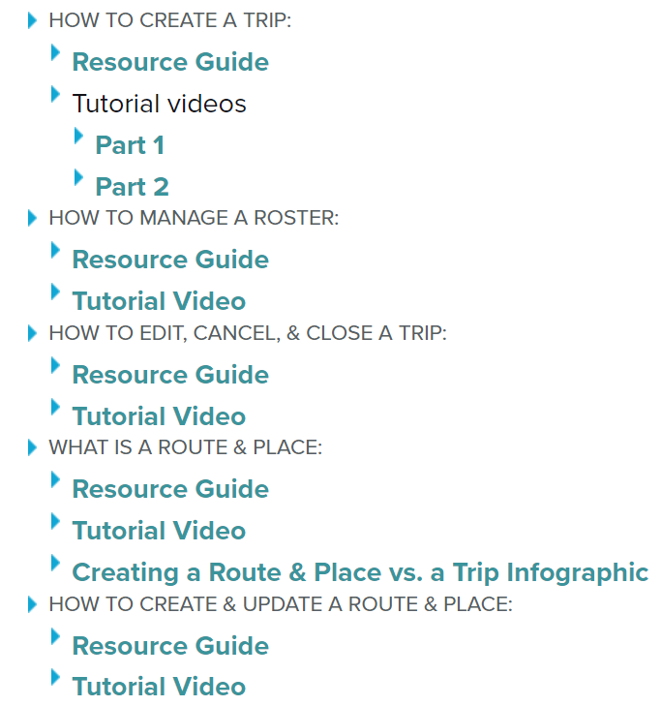
Additional Resources
Badge Request Form
https://docs.google.com/forms/d/e/1FAIpQLSdIIzru9pc6Wr3GwjHRS0Q1olnJbwgkXHyyaRMwlGWhcxTW0w/viewform
Website questions or concerns for the Education Team
https://docs.google.com/forms/d/e/1FAIpQLScMAfOM4tg_7PhhBqhKggY8q8-dls9w2jfmQUOtx8SATNK-bQ/viewform?usp=sf_link
Leader Resources

