Slide 1
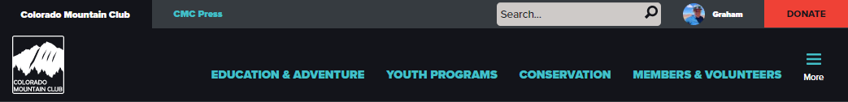
Website Tips & Tricks
Training 8
Roster Management 201

Slide 2
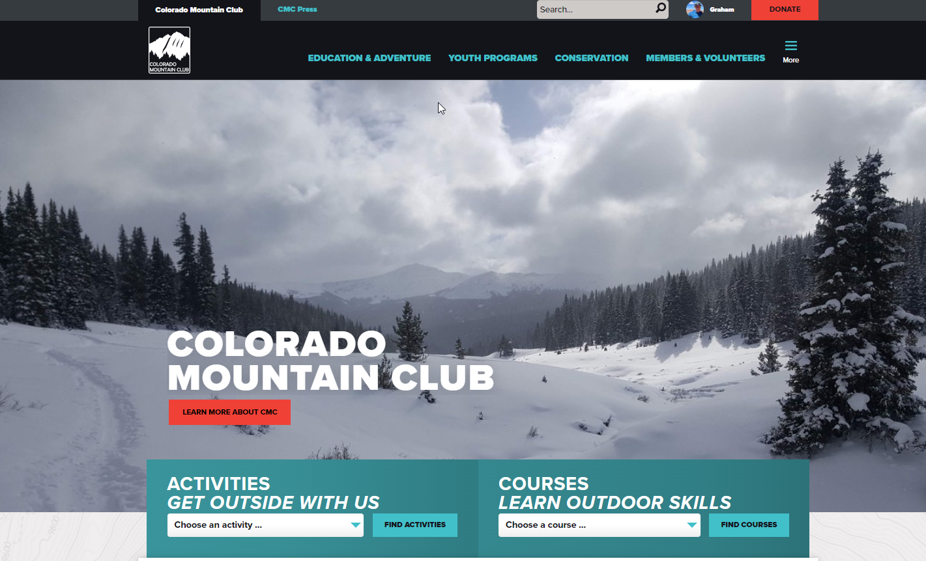


Slide 3
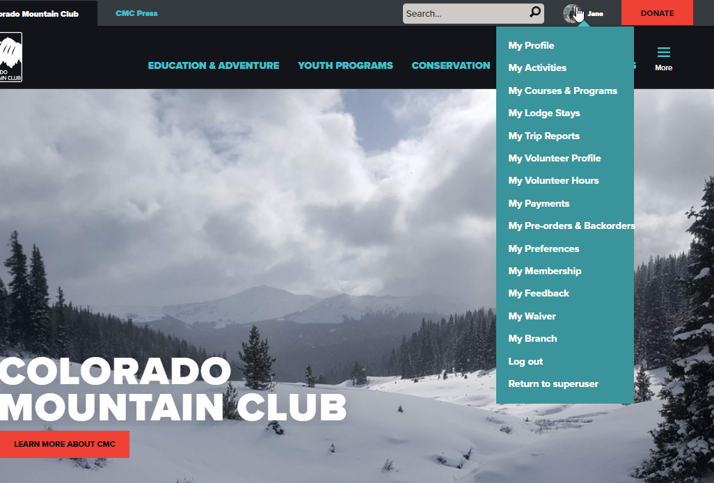
Hover over profile
Select “Courses & Programs”

Slide 4
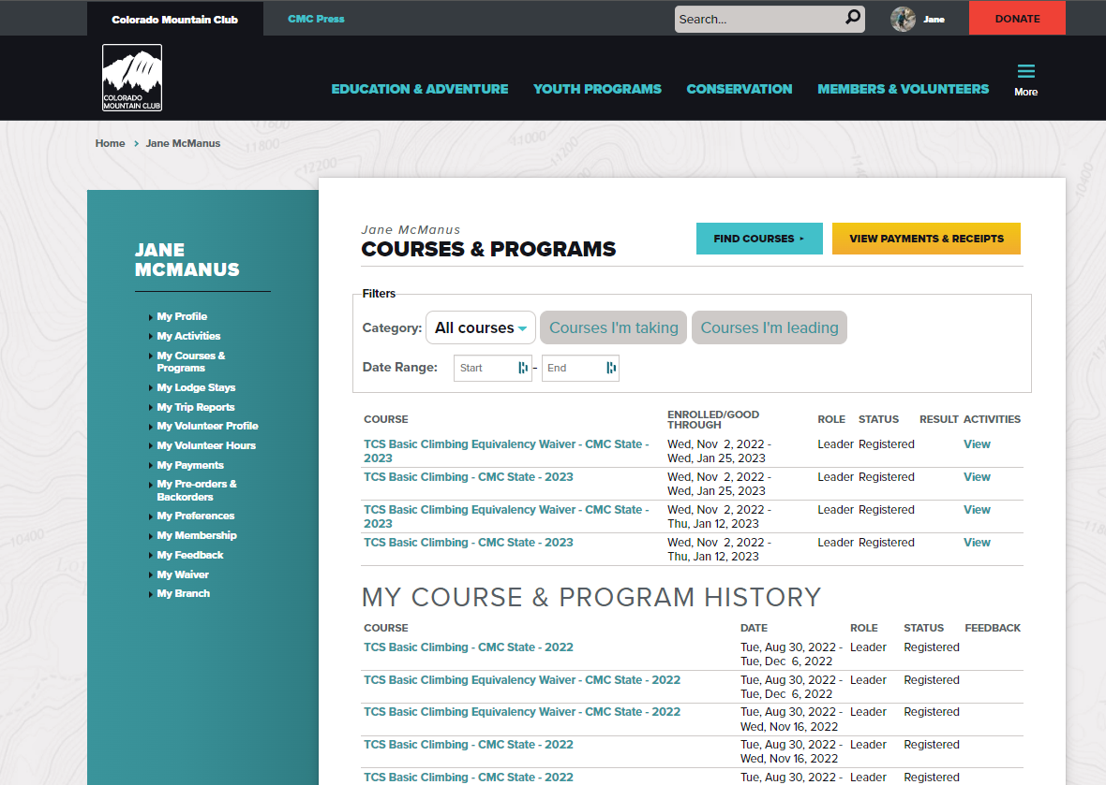
Select the Course you want to manage the roster of.

Slide 5
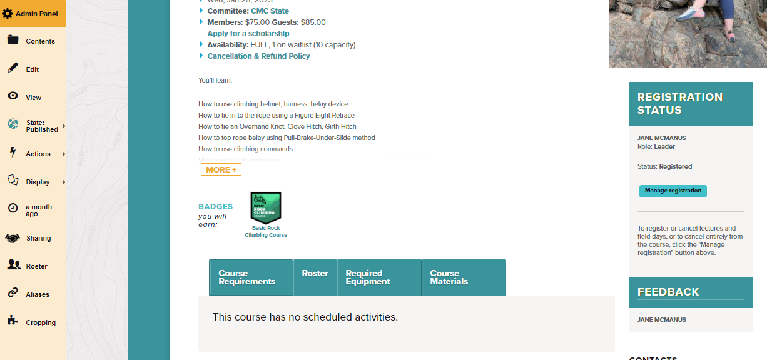
Select Roster in Admin panel

Slide 6
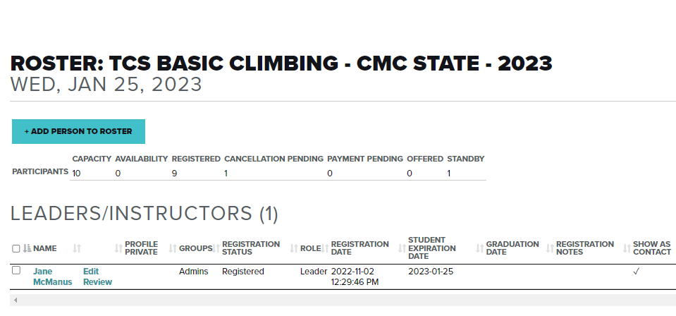
Select Roster in Admin panel

