Slide 1
Website Tips & Tricks
Training 4
Making the most of your User Profile options

Slide 2
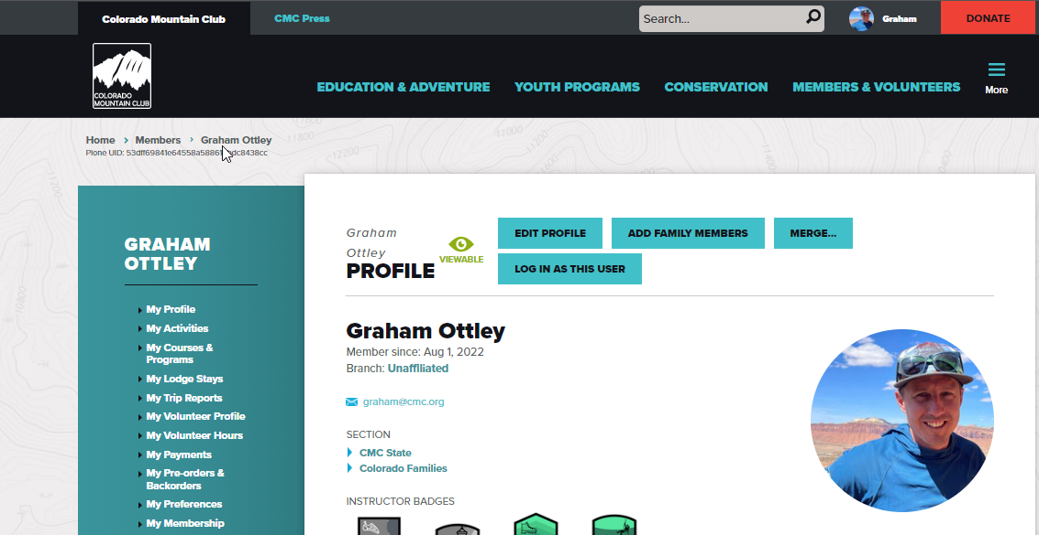
My Profile

Slide 3
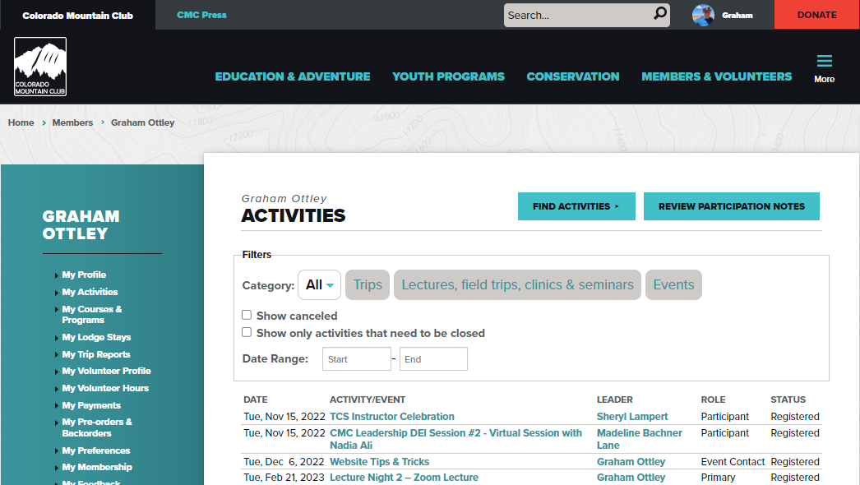
My Activities

Slide 4
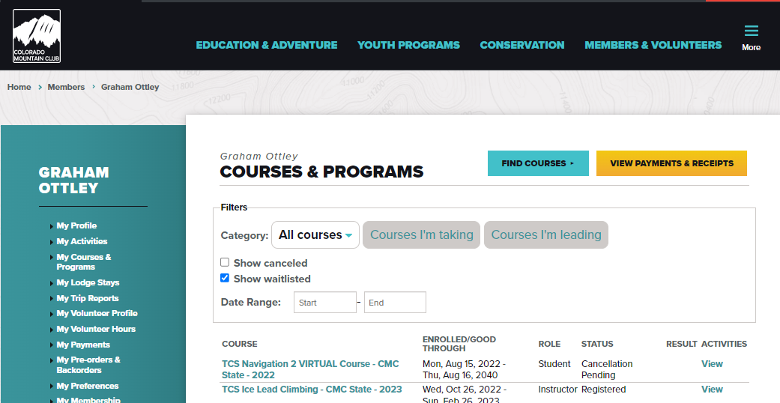
My Courses & Programs

Slide 5
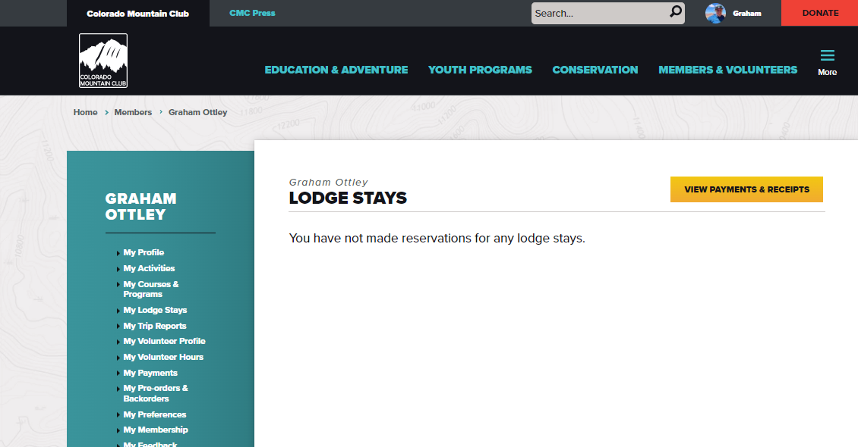
My Lodge Stays

Slide 6
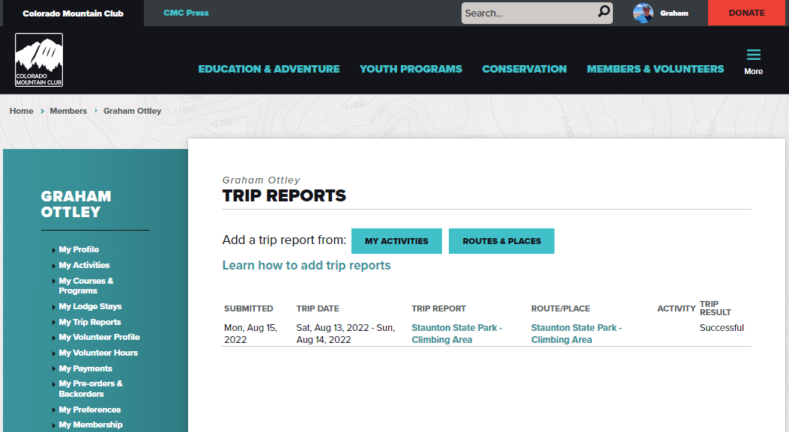
My Trip Reports

Slide 7
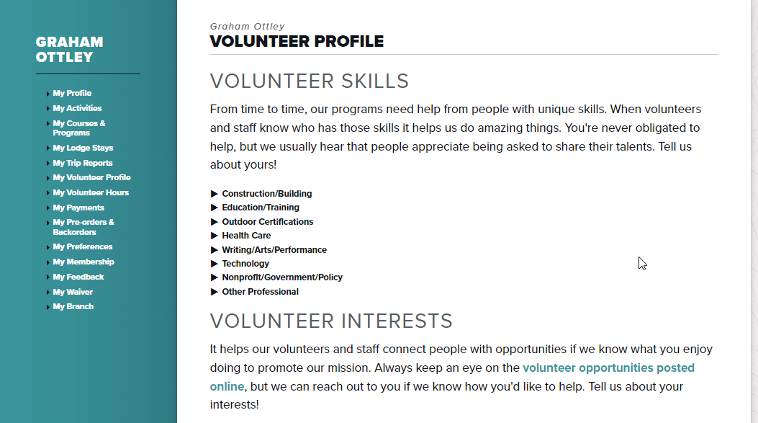
Volunteer Profile

Slide 8
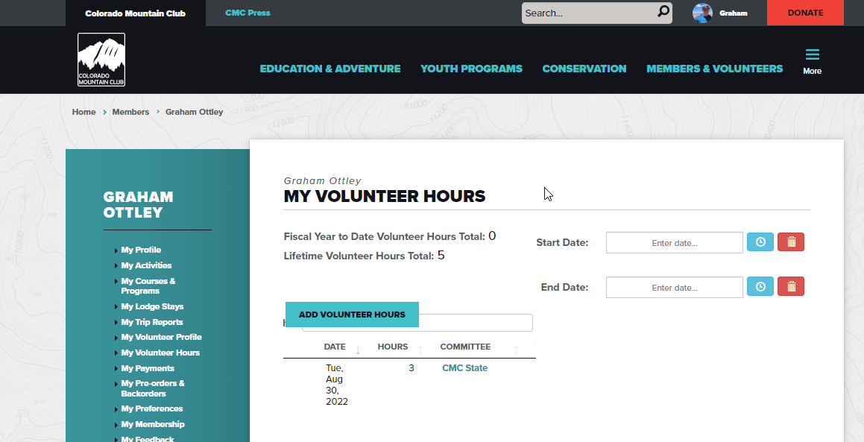
Volunteer Hours

Slide 9
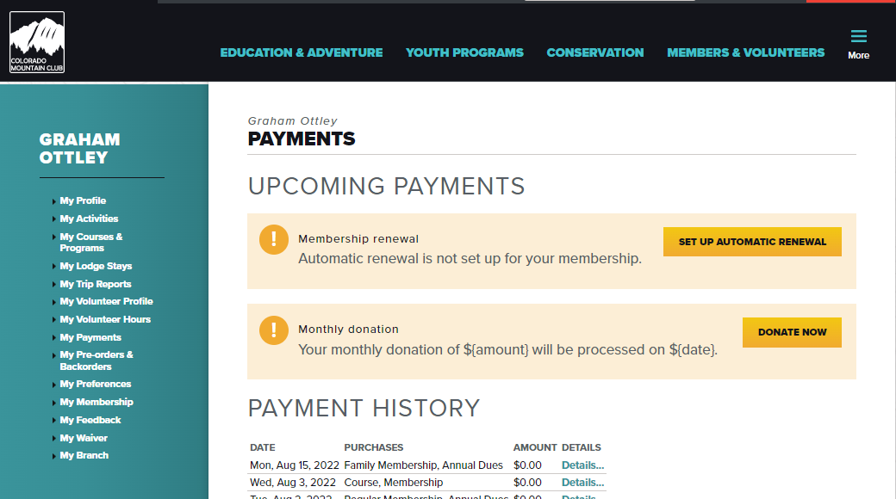
Payments

Slide 10
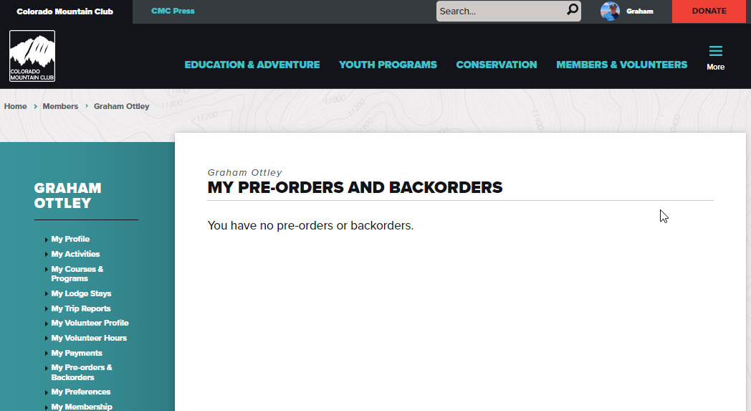
Pre Orders and Backorders

Slide 11
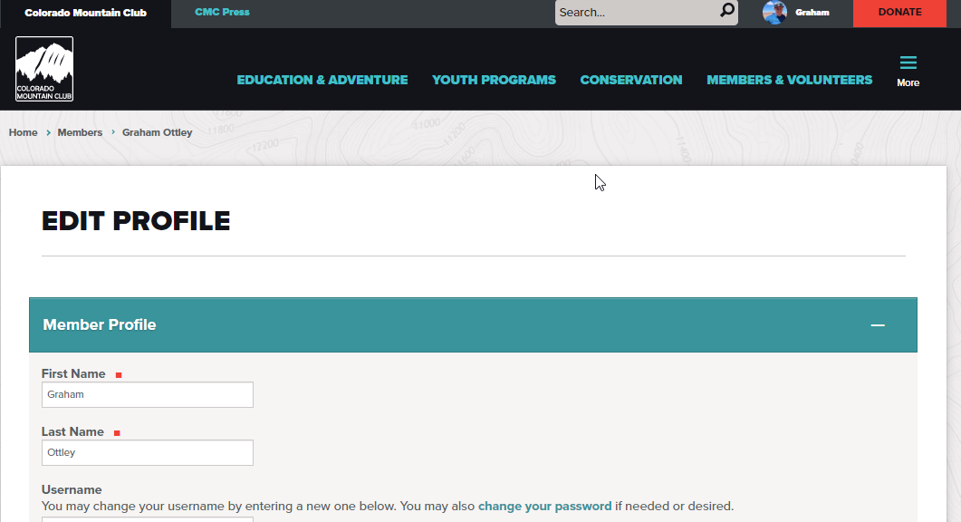
Preferences

Slide 12
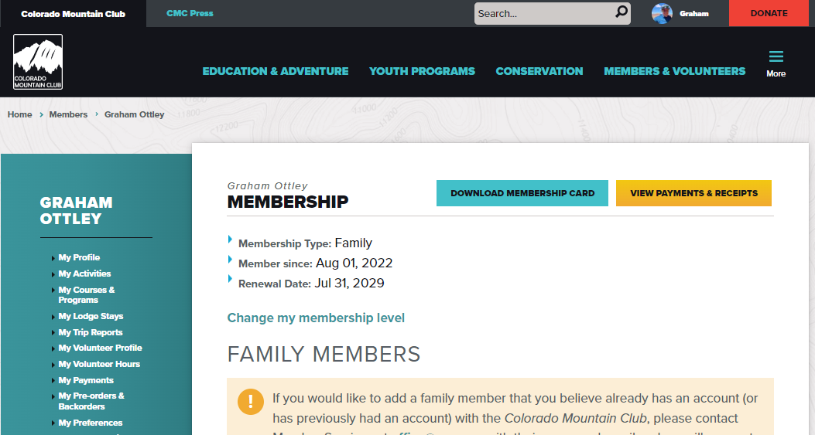
Membership

Slide 13
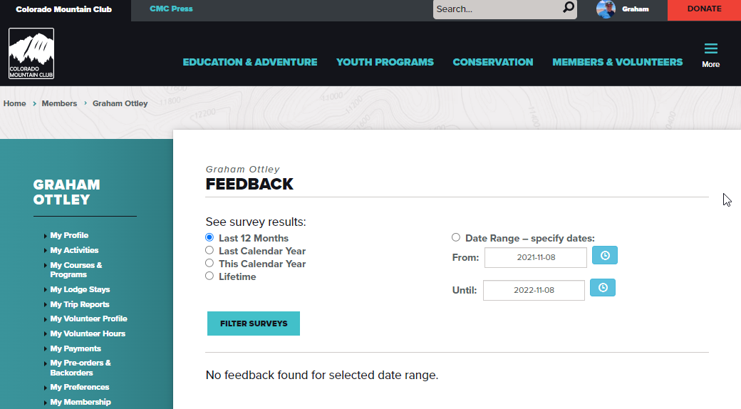
Feedback

Slide 14
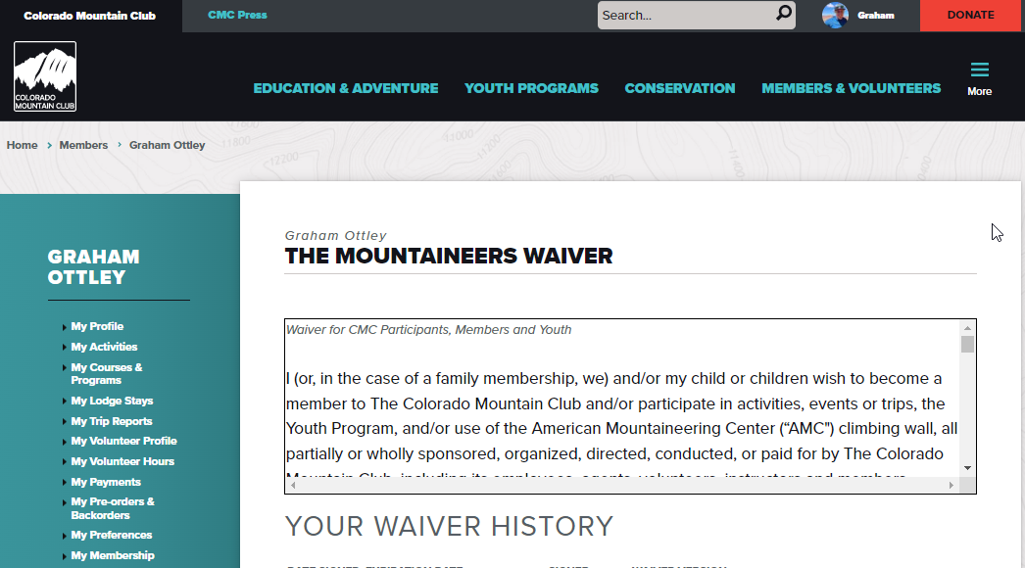
My Waiver

Slide 15
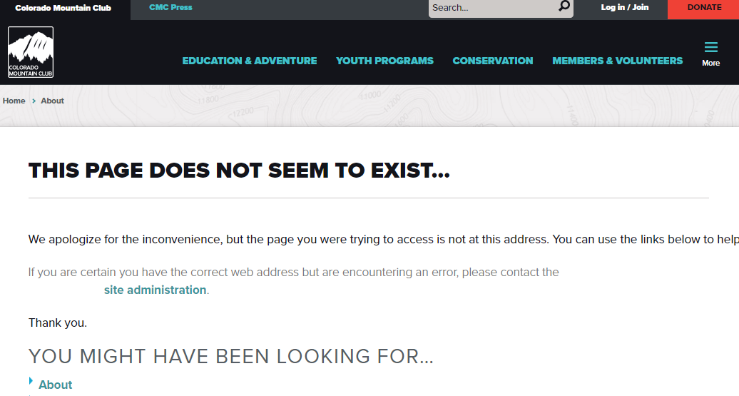
My Branch

Slide 16
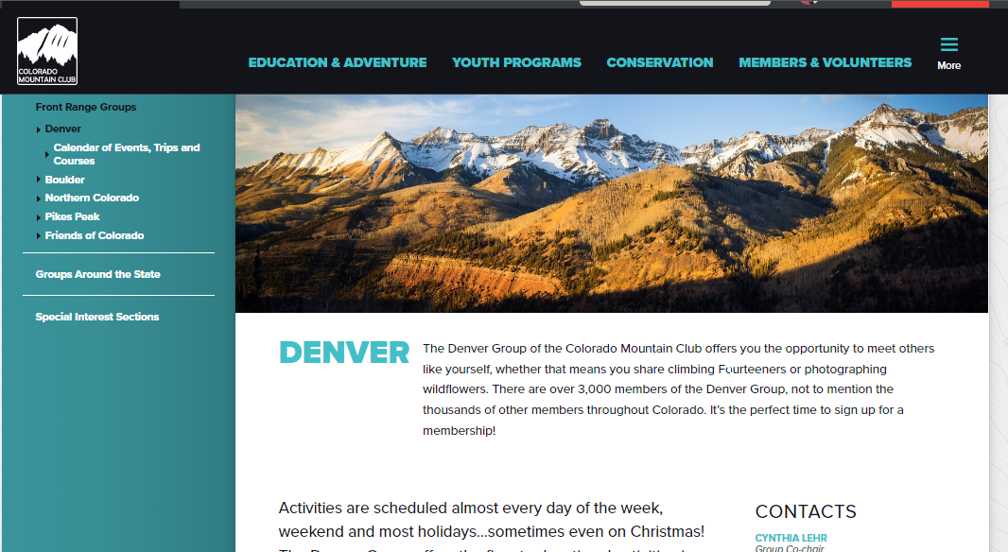
My Branch

Slide 17
My Branch

Slide 18
Questions
Other questions?

Slide 19
Questions
Q:
A:
Q:
A:
Q:
A:

